Slide 1
JSON(JavaScript Object Notation) File Handling

Slide 2
Team’s Code
uddfmzr

Slide 3
JSON file structure
{"employees":[
{"name":"Sunny", "email":”sunny@gmail.com"},
{"name":"Rahul", "email":"rahul32@gmail.com"},
{"name":"John", "email":"john32bob@gmail.com"}
]}
JSON stands for JavaScript Object Notation.
JSON is lightweight data-interchange format.
JSON is language independent.
JSON supports array, object, string, number and values.

Slide 4
JSON Data types
Data Type | Description | Example
String | A string is always written in double-quotes. It may consist of numbers, alphanumeric and special characters. | "student", "name", "1234", "Ver_1"
Number | Number represents the numeric characters. | 121, 899
Boolean | It can be either True or False. | true
Null | It is an empty value.

Slide 5
JSON object
JSON objects refer to dictionaries, which are enclosed in curly brackets, i.e., { }.
{"name" : "Jack", "employeeid" : 001, "present" : false}
{
"employee": {
"name": "sonoo",
"salary": 56000,
"married": true
}
}

Slide 6
JSON Array
[{
"PizzaName" : "Country Feast",
"Base" : "Cheese burst",
"Toppings" : ["Jalepenos", "Black Olives", ", "Cherry tomatoes"],
"Spicy" : "yes",
},
{
"PizzaName" : "Veggie Paradise",
"Base" : "Thin crust",
"Toppings" : ["Jalepenos", "Black Olives", "Cherry tomatoes"],
"Spicy" : "yes",
}
]

Slide 7

Attendance

Slide 8
Reading JSON File
import json
# Sample JSON data in "data.json"
# {"name": "John Doe", "age": 30, "city": "New York"}
file_path = "data.json"
# Reading JSON data from the file
with open(file_path, "r") as json_file:
data = json.load(json_file)
print(data)
# Output: {'name': 'John Doe', 'age': 30, 'city': 'New York'}

Slide 9
Writing JSON file
import json # Sample Python dictionary
data = {
"name": "John Doe",
"age": 30,
"city": "New York"
}
# Writing JSON data to a file
file_path = "output.json"
with open(file_path, "w") as json_file:
json.dump(data, json_file)
# The "output.json" file will contain: {"name": "John Doe", "age": 30, "city": "New York"}

Slide 10
Problem Statement
You are working as a data scientist for a healthcare organization, and your team has been tasked with analyzing COVID-19 data from multiple countries. The data is stored in JSON files, with each file representing the daily COVID-19 statistics for a specific country. Each JSON file has the following structure:
{ "country": "Country Name",
"date": "YYYY-MM-DD",
"confirmed_cases": { "total": 1000, "new": 50 },
"deaths": { "total": 20, "new": 2 },
"recovered": { "total": 800, "new": 30 }
}

Slide 11
Loading JSON Data as Python Objects:
import json # Sample JSON data in "nested_data.json"
# {"person": {"name": "John Doe", "age": 30}, "city": "New York"}
file_path = "nested_data.json" # Reading JSON data from the file
with open(file_path, "r") as json_file:
data = json.load(json_file)
print(data)
# Output: {'person': {'name': 'John Doe', 'age': 30}, 'city': 'New York'}
print(data['person']['name'])
# Output: 'John Doe'

Slide 12
Your task is to write a Python program that performs the following operations:
Read COVID-19 data from all JSON files in a given directory and its subdirectories.
Calculate and display the following statistics for each country:
Total confirmed cases.
Total deaths.
Total recovered cases.
Total active cases (total confirmed cases minus total deaths and total recovered).
Determine the top 5 countries with the highest number of confirmed cases and the lowest number of confirmed cases.
Generate a summary report in JSON format that includes the statistics for all countries and save it to a file named "covid19_summary.json".

Slide 13
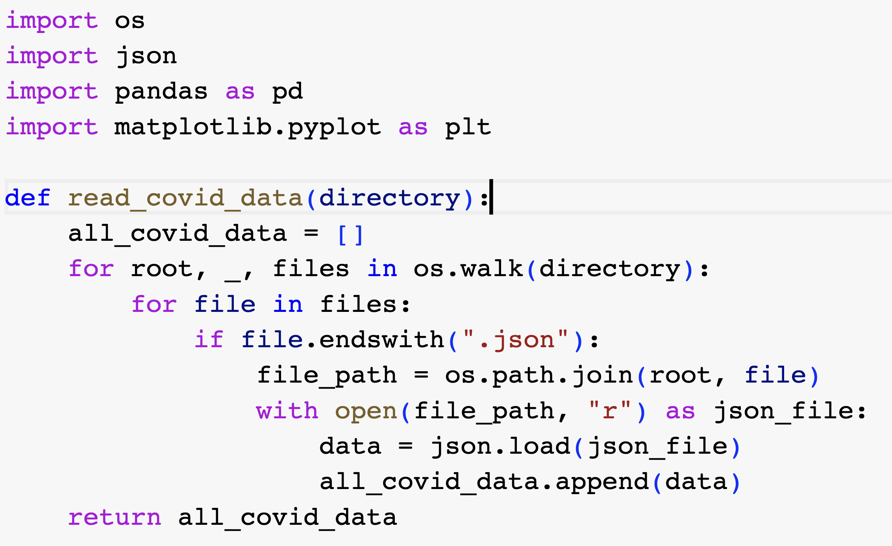

Slide 14
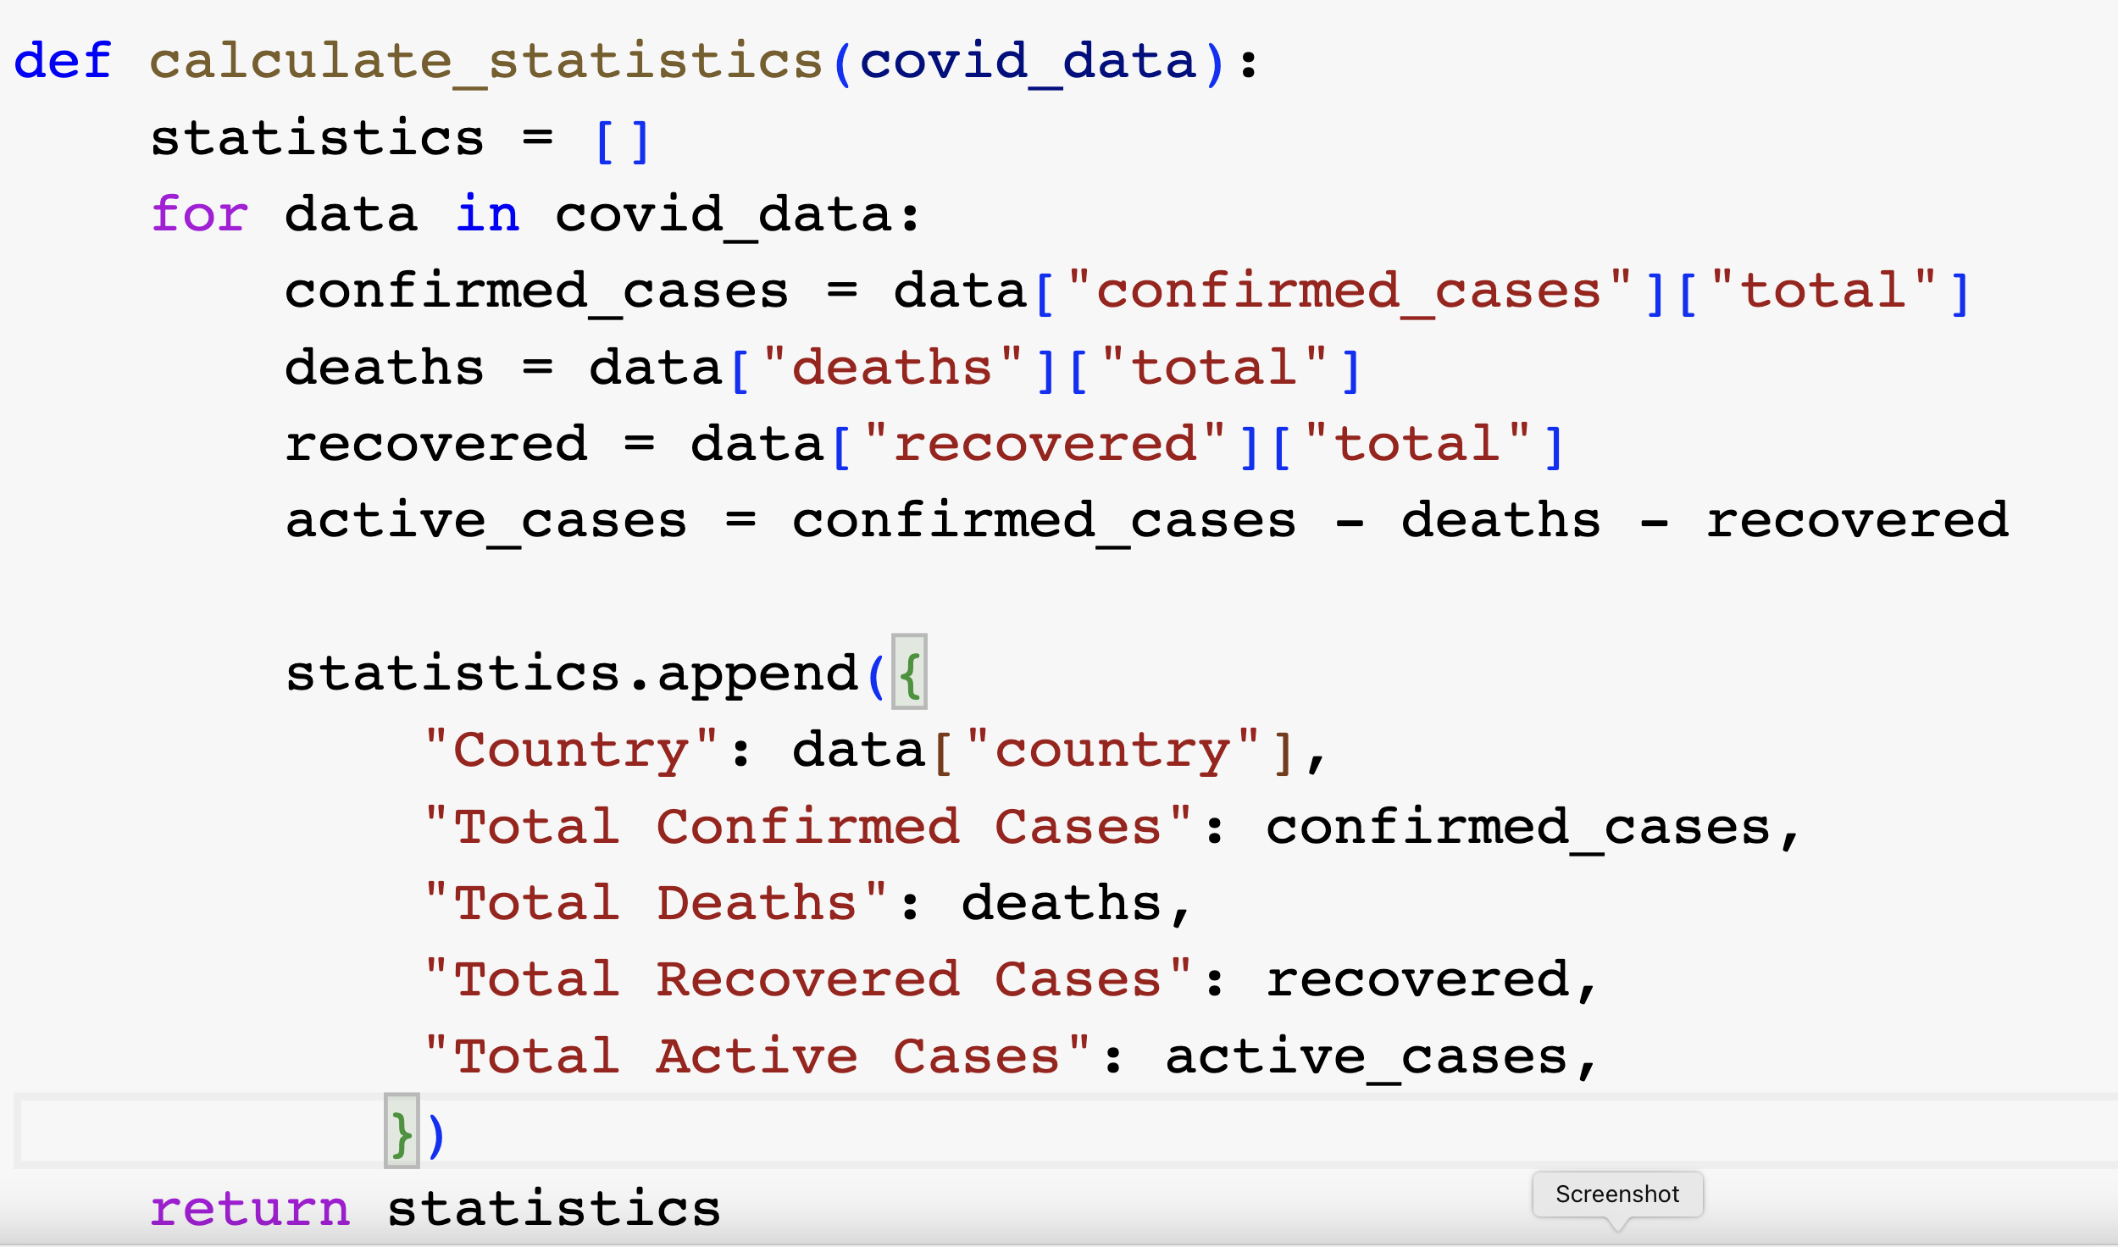

Slide 15
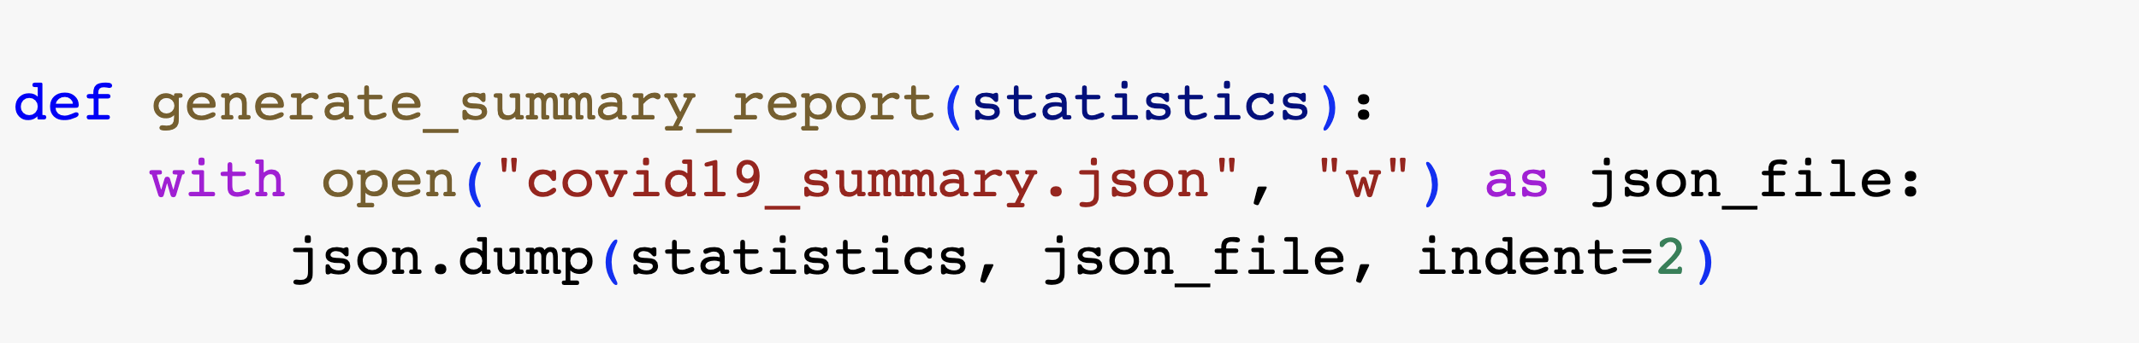

Slide 16
